Slide 1
AAWAZ The Debating Society of Zakir Husain Delhi College (eve)
ORIENTATION 2021
Presentation by:- Yash Awasthi

Slide 2
About us✒
Zakir husain delhi college has always stood steadfast as a champion of some basic values which have acquired greater relevance in contemporary times. The college in its long history has accommodated students and faculty of different communities. Zakir husain college is the oldest college of delhi. It was established as a Madarsah by ghaziuddin firoz jung in 1780 outside ajmeri gate. It later developed into delhi college in 1825 when it was popularly known as "dilli college". During the middle of the 19th century, due to political upheavals like the great uprising of 1857, it had to be shut down. It was reopened and was shifted to kashmiri gate. In 1975, the college was taken over by dr. Zakir husain memorial college trust and was re-named as zakir husain college. Zakir husain delhi college (evening) is managed by the trust, with the prime minister of india in the chair. Evening classes were introduced in 1958.The college actively encourages young boys and girls to strive for the attainment of their highest potential by providing the impetus for them to become worthy citizens of the country. Many of our alumni have excelled in various fields of arts, culture and science and quite a few have obtained prestigious positions in the public and private sectors.To cite a few cases, mr. Hasan ahmad, former chairman of delhi state industries development corporation, mr. Haroon yousuf, a minister in the delhi government, mr. Shakti chand sharma, former principal of ram lal anand evening college and mr. Ramesh sharma (divik ramesh), former principal of motilal nehru college, dr. S.Y. Quraishi, chief election commissioner of india, all have been associated with the evening college.
Presentation by:- Yash Awasthi

Slide 3
AAWAZ- The Debating Society of ZAKIR HUSAIN DELHI COLLEGE EVENING, DELHI UNIVERSITY, proudly presents ORIENTATION 2021 AAWAZ have been conducting critically acclaimed flagship events and several competitions year on year, such as Conventional Debates, Debates of national level, Panel Discussions and Workshops regarding speaking skills and confidence enhancement .We also have our annual Debating festival, AAWAZ. Each of these events and our annual festival have witnessed participation from a huge group of students from colleges across the city. AAWAZ has a wide spread publicity campaign through which colleges across the city are being reached, with the assistance of the team of the society which draws in a large number of students from institutions. Being quite a popular society among the university Aawaaz is sure to draw in a lot of media coverage as well.
Presentation by:- Yash Awasthi

Slide 4
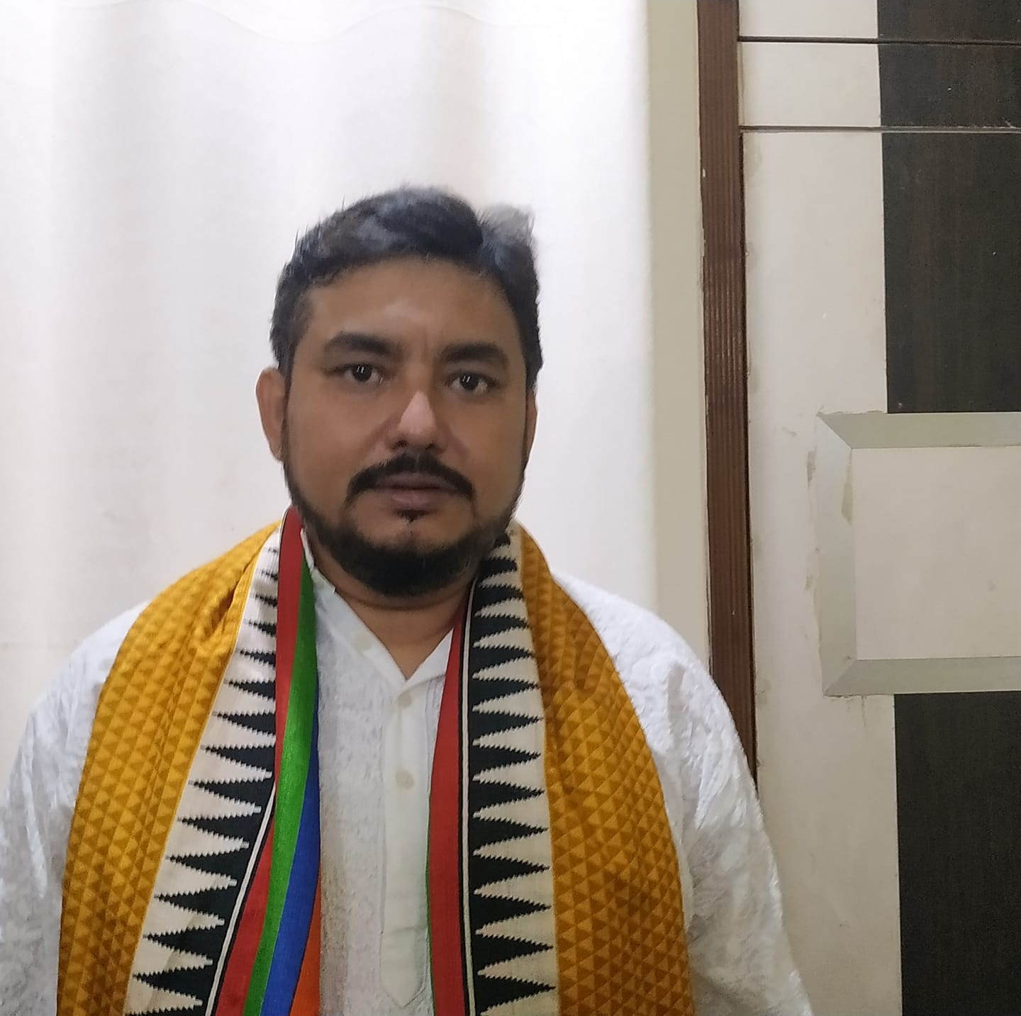
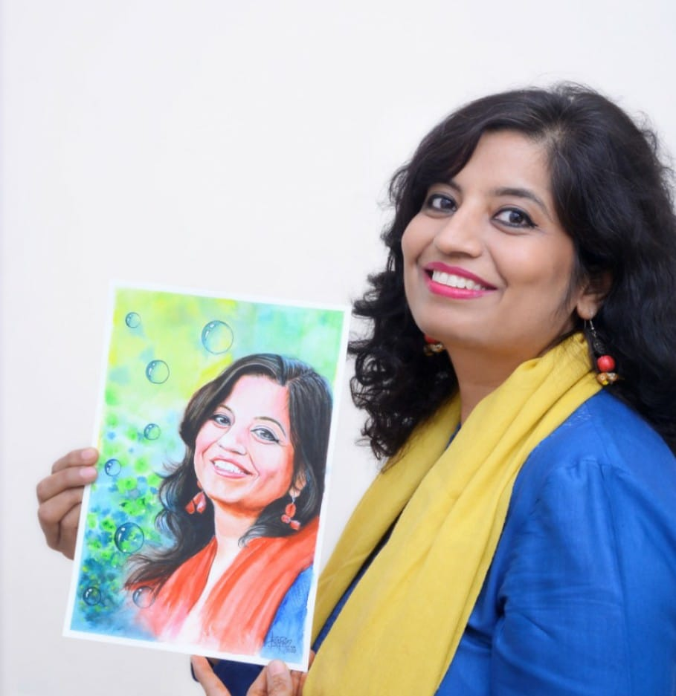
Convenor 2021
DR. Munshi Younus
Dr. Neelima Chauhan

Slide 5
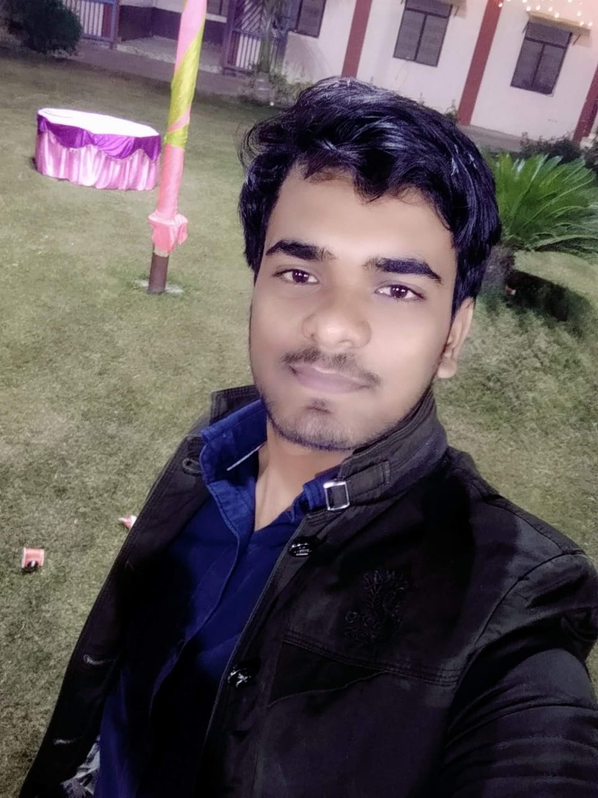
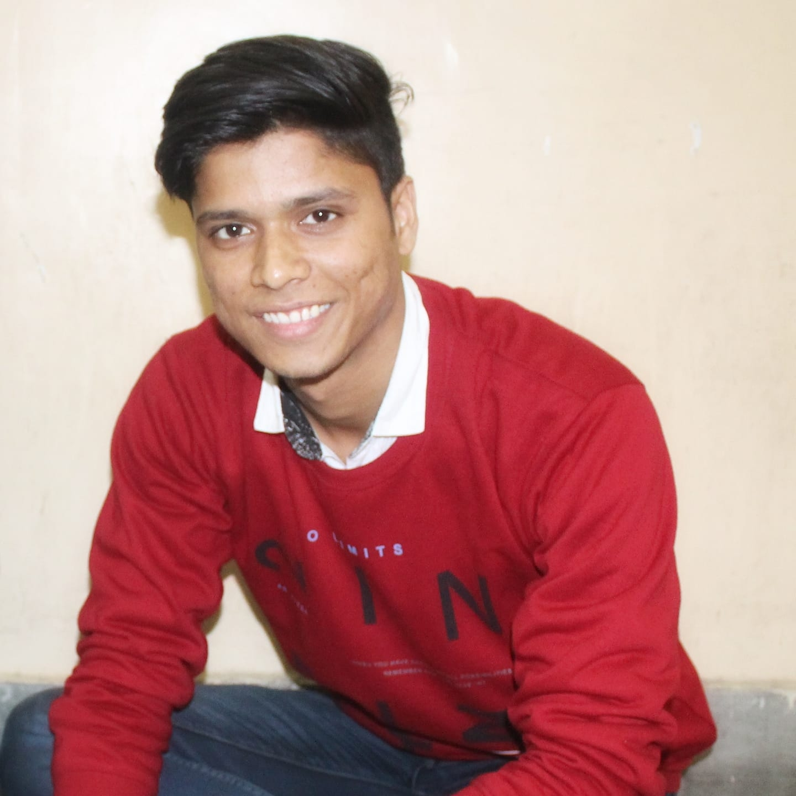
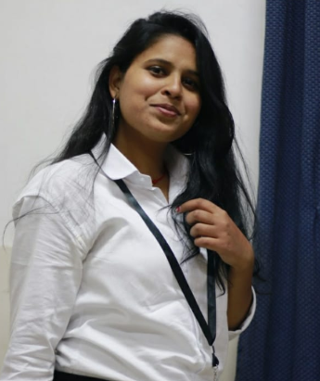
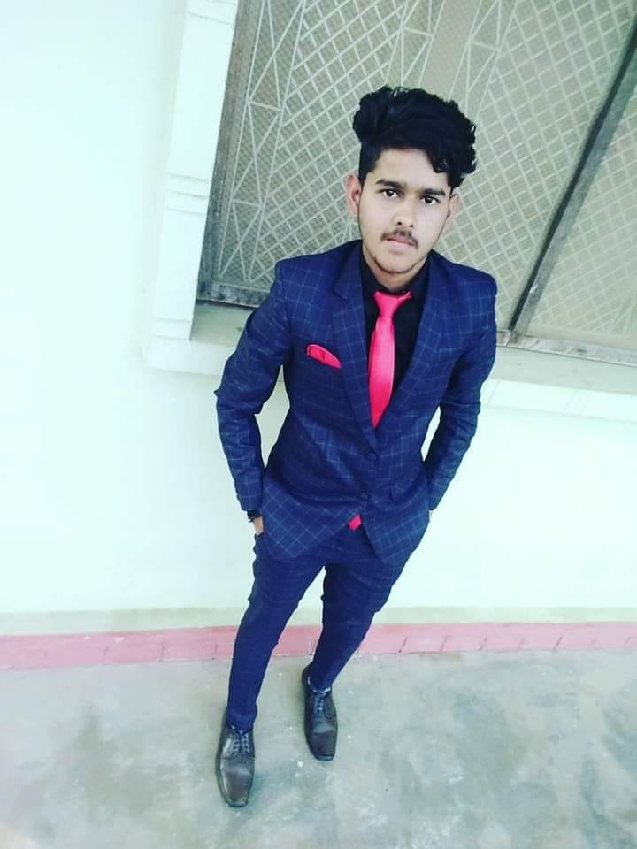
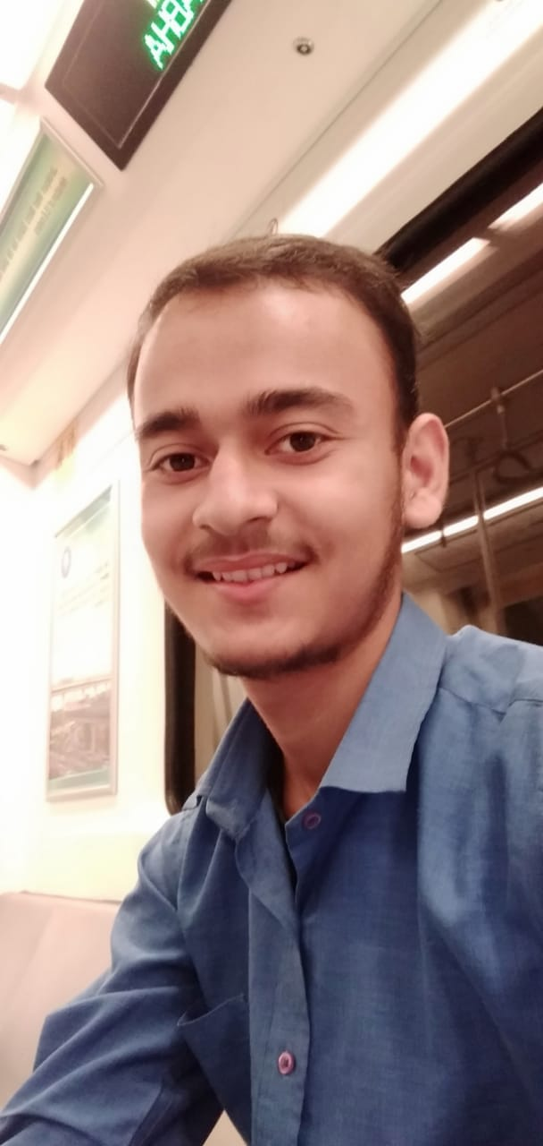
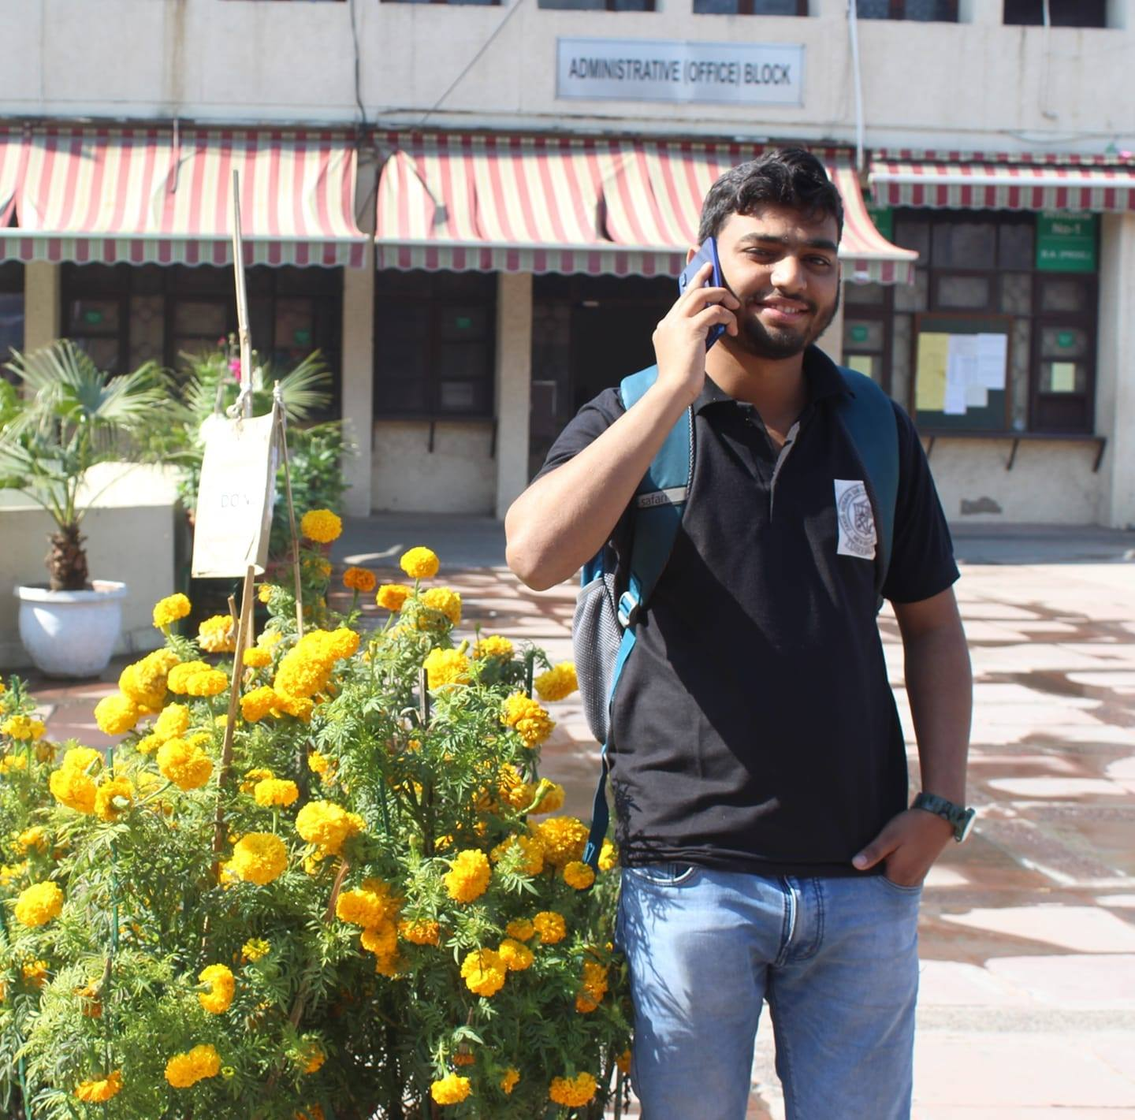
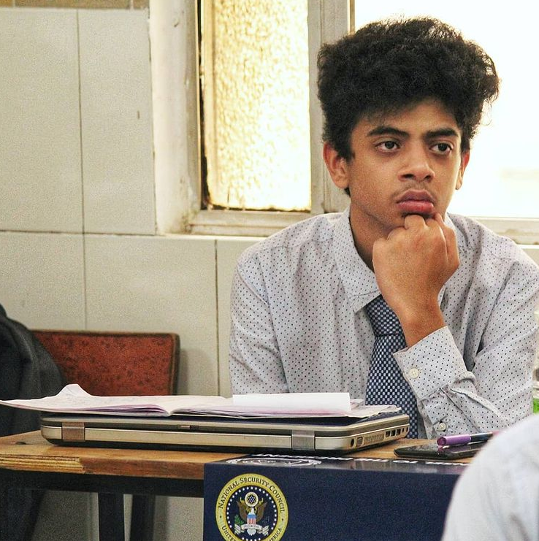
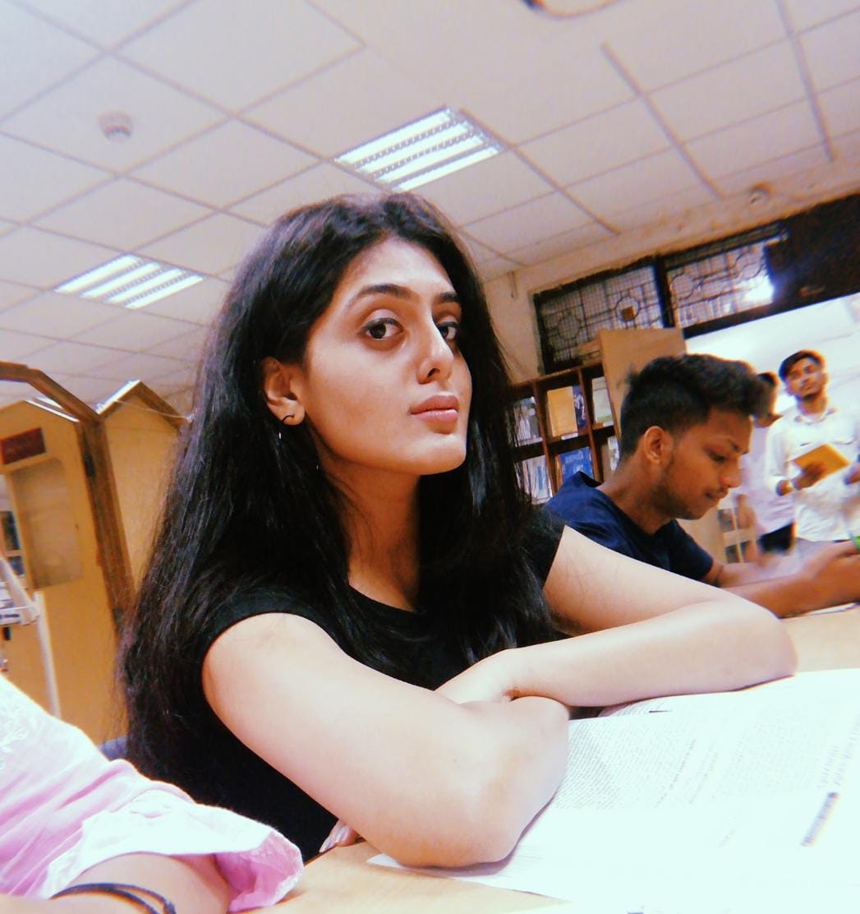
Organising Team
Presentation by:- Yash Awasthi

Slide 6
Presentation by:- Yash Awasthi

Slide 7
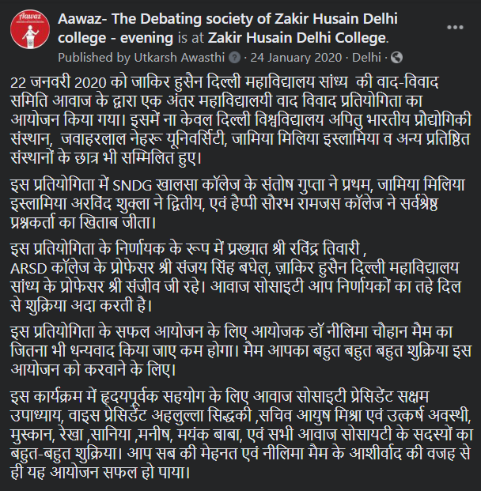
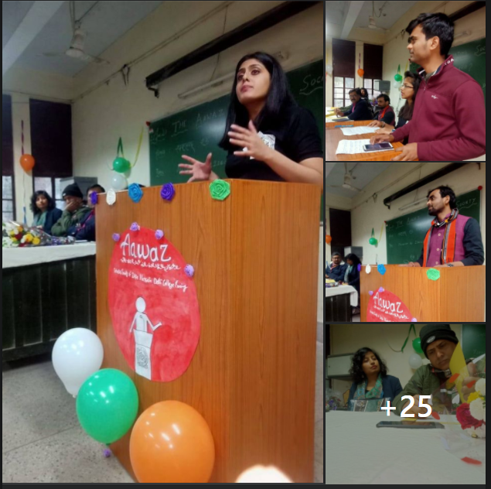
Presentation by:- Yash Awasthi

Slide 8
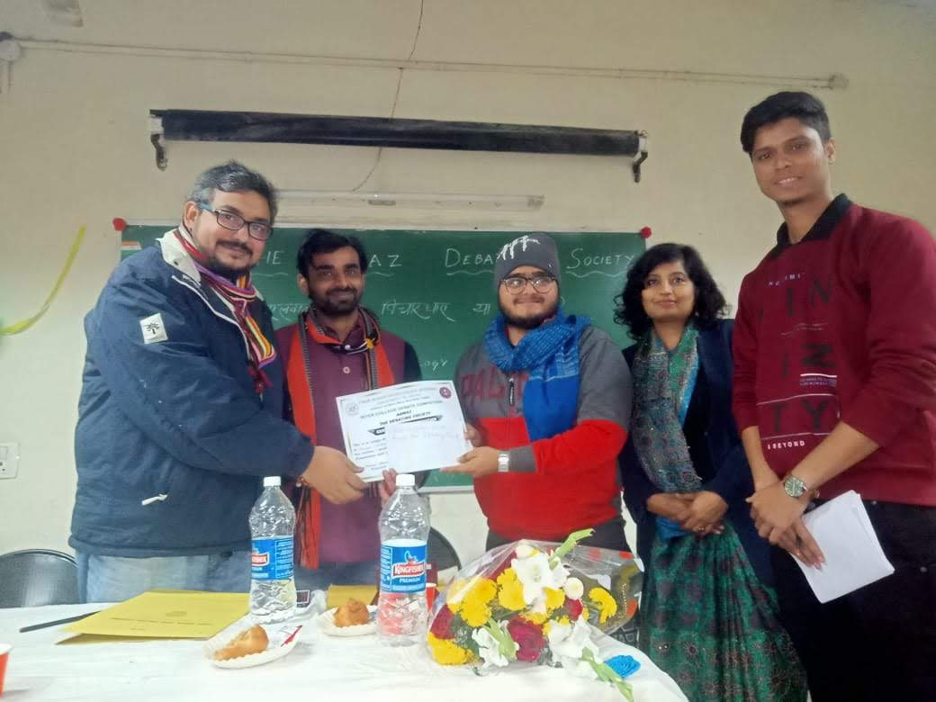
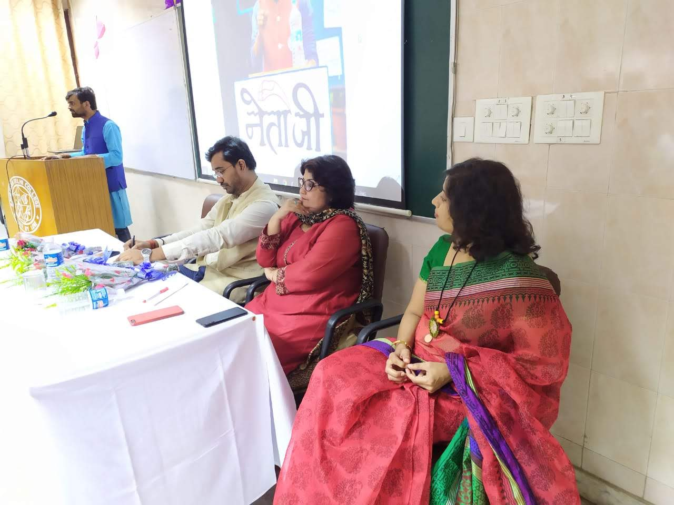
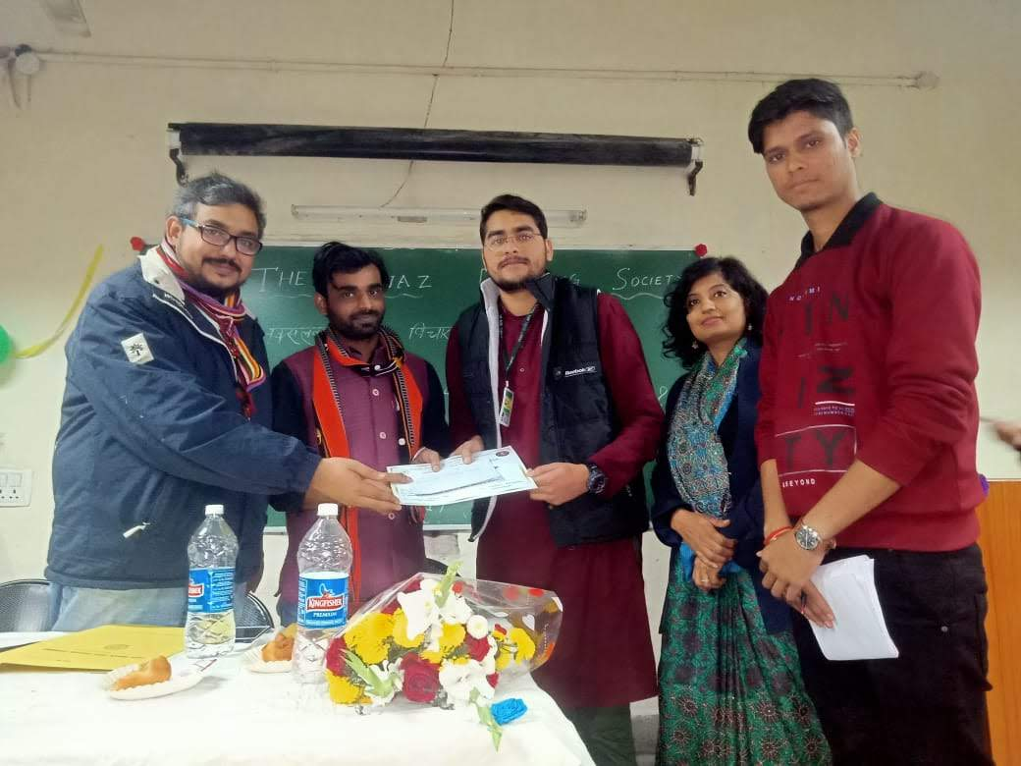
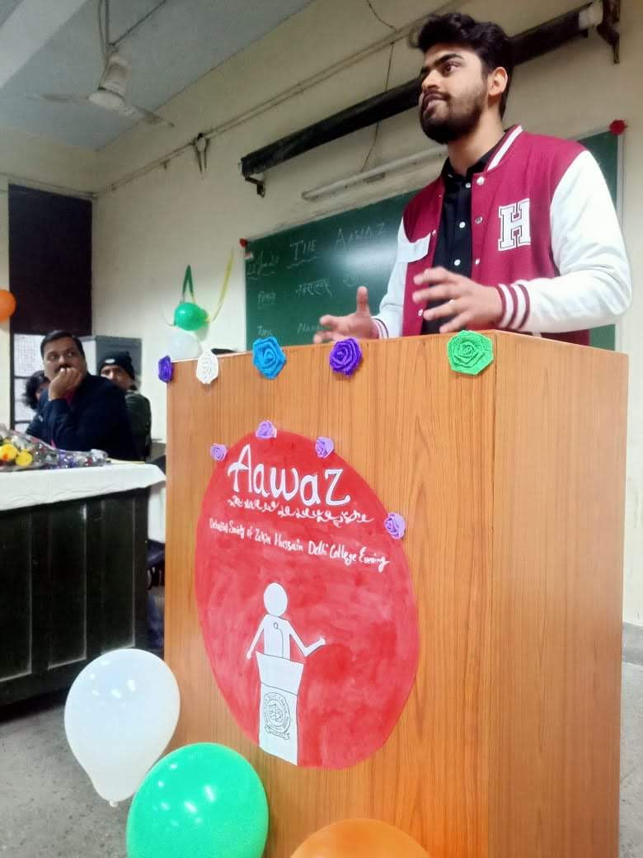
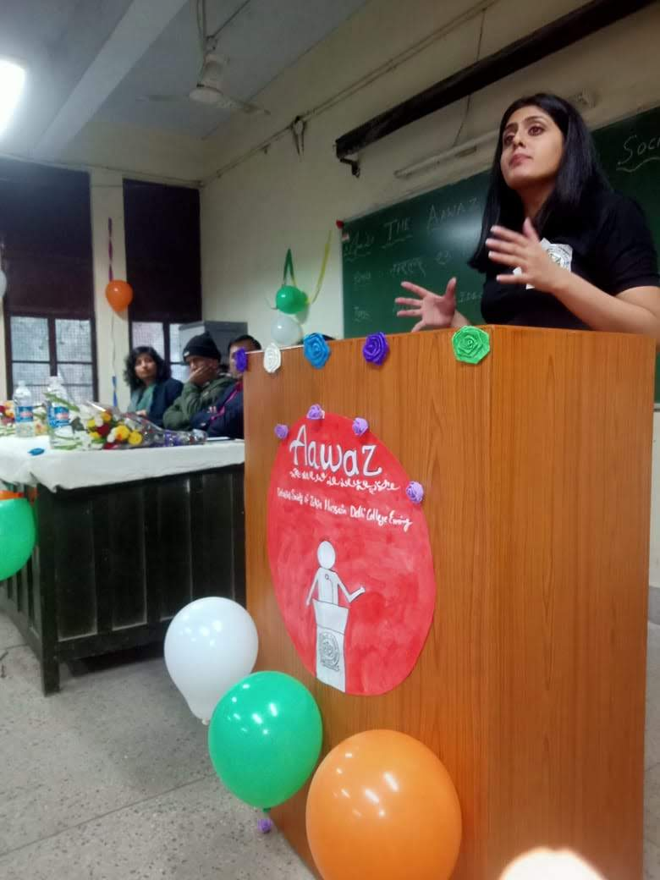
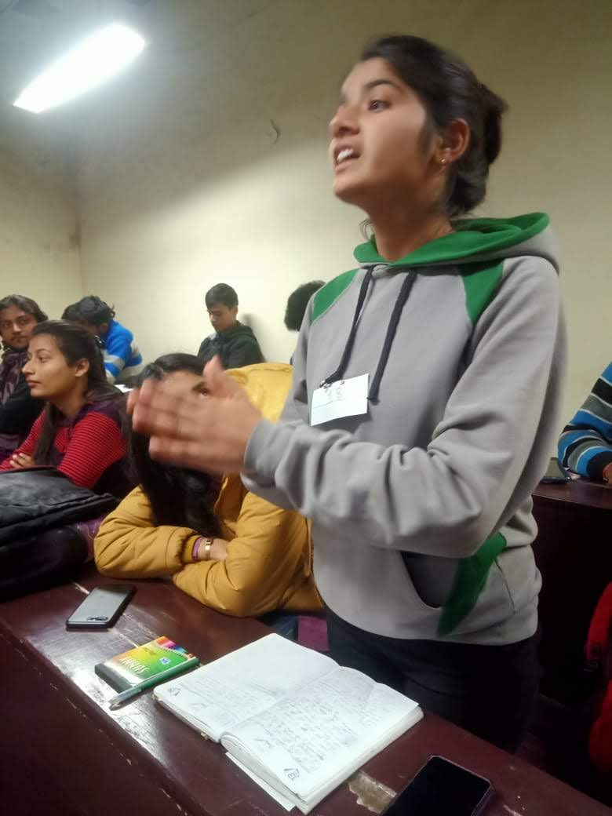
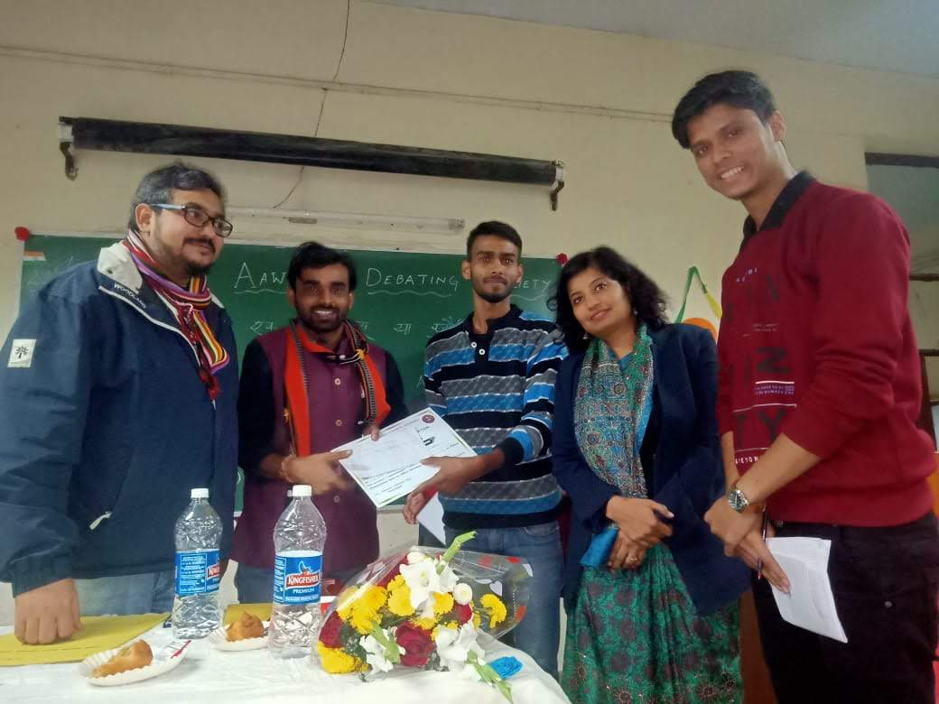
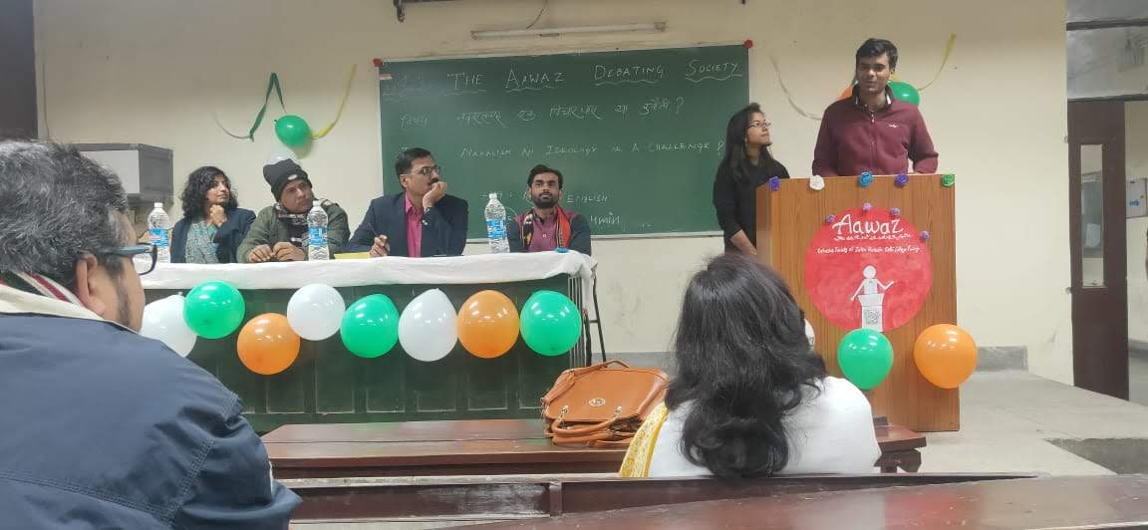
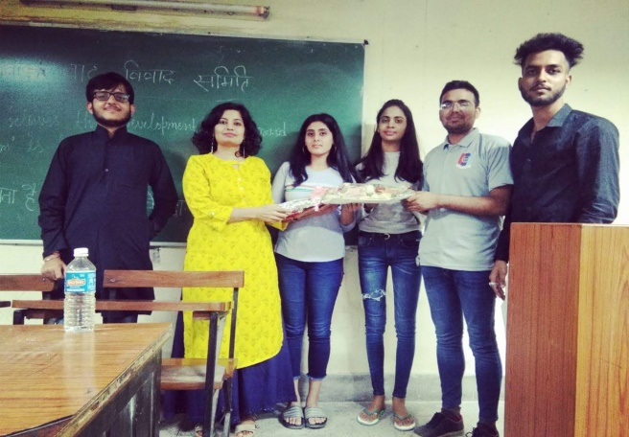
Presentation by:- Yash Awasthi

Slide 9
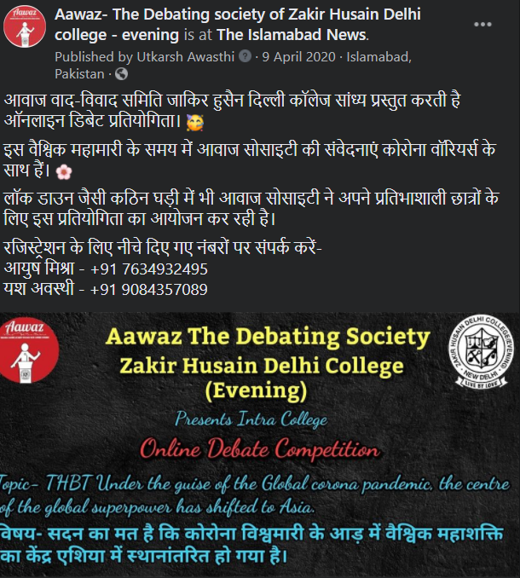
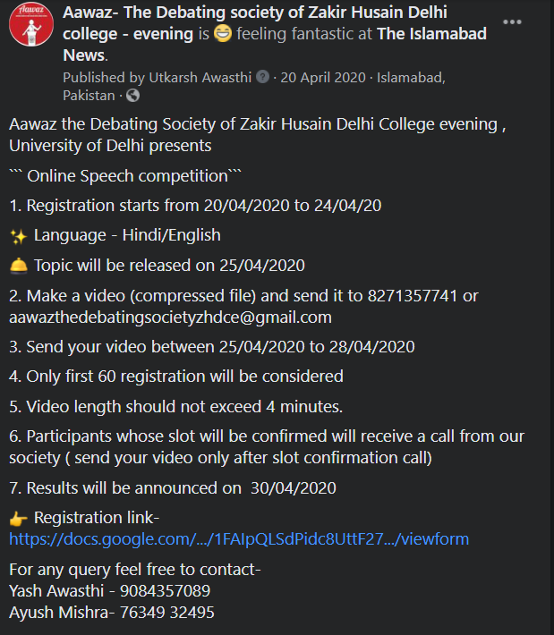
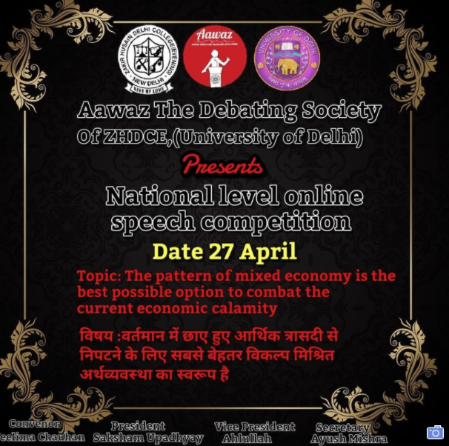
Presentation by:- Yash Awasthi

Slide 10
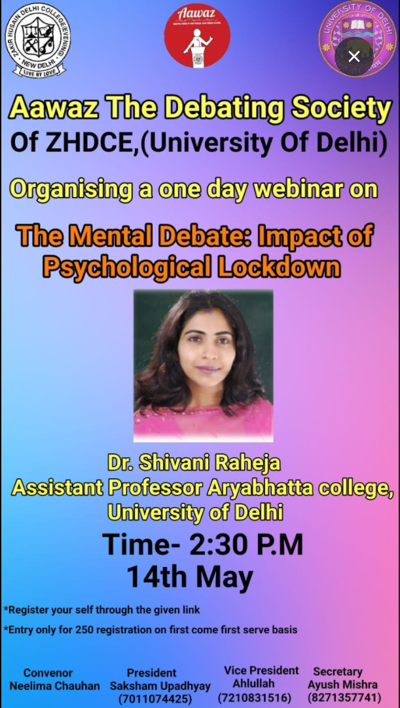
Presentation by:- Yash Awasthi

Slide 11
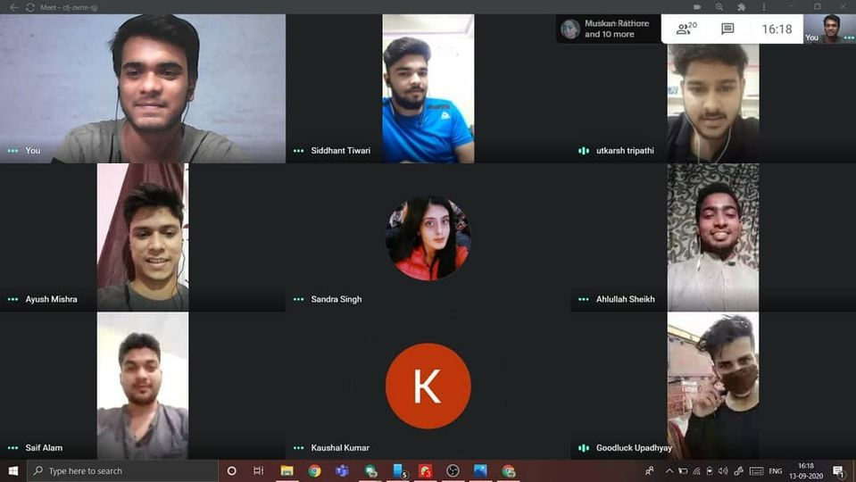
Presentation by:- Yash Awasthi

Slide 12
https://drive.google.com/file/d/1lg_UcdU4Kv4aye_ZkwRV1n6XFr-MXYpr/view?usp=drivesdk
Presentation by:- Yash Awasthi

Slide 13
Presentation by:- Yash Awasthi

Slide 14
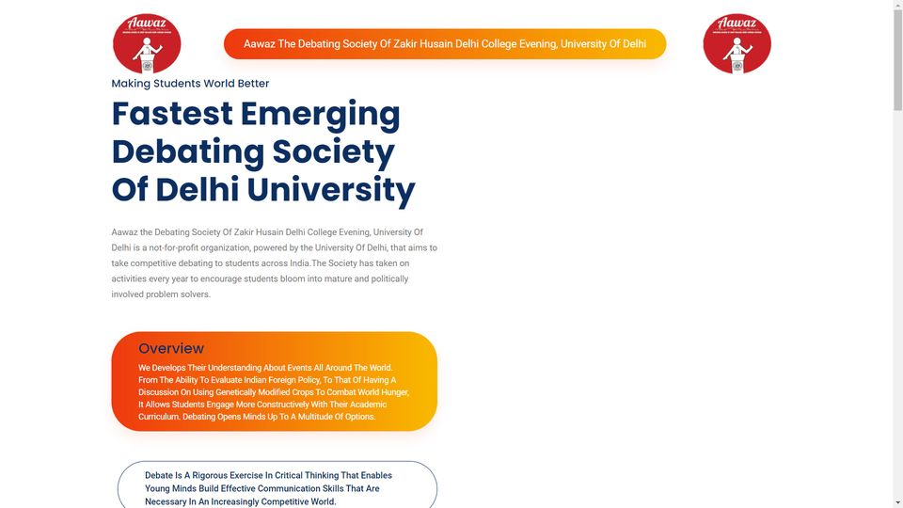
Click here
Presentation by:- Yash Awasthi

Slide 15
Rules and regulations you must keep in mind in order to make sure proper and smooth functioning of the society- 1) Attending society meeting is must for all members on a weekly basis as per the prospectus of the society. 2) Taking part in maximum debates should be your foremost priority and function to be performed by you. 3) Society's welfare must supersede your personal interest as when society will develop and grow, your personal interest of learning would be fulfilled. 4) Society's union decision would be paramount and binds all members in one thread. 5) Democratic way of working take place in the society, you all will be given an opportunity to provide your suggestions and opinions but once decision has been taken by society union, you won't be able to intervene in between the process. Thankyou!
Presentation by:- Yash Awasthi

Slide 16
6) Whenever you visit to a college for debating purpose, try to restrict yourself to a certain limits and focus to have a discussion with your partner until and unless you are done with your debate. 7) Don't share our society's grievance with any other society inside or outside the college as we are one family in order to protect society's privacy. 8) Adhere to the timing of meetings to be organised throughout your college life . 9) Try to refrain yourself from giving excuses of the class and avoid procastinating things. 10) Whenever you see any debate notification in the group ,don't fill the registration form by your name because making registration is the responsibility of one of our active member of the society whose name is Abrar Alam. 10) Attending meeting is compulsory as well as mandatory for your growth and development .If you are not attending then your absenstism must be accompanied by legitimate reason. Otherwise, no any excuse shall be entertained. Thankyou!
Presentation by:- Yash Awasthi

Slide 17
वाद विवाद समिति के उचित और सुचारू कामकाज को सुनिश्चित करने के लिए समिति के द्वारा जारी किए हुए कुछ निर्देश- १) साप्ताहिक आधार पर समिति के सभी सदस्यों को मीटिंग में मौजूद रहना अनिवार्य है। २) आप सभी की पहली प्राथमिकता ज्यादा से ज्यादा वाद-विवाद प्रतियोगिताओं में भाग लेना होना चाहिए, ताकि समिति एक उच्चतम स्तर तक पहुंच सके। ३) वाद विवाद समिति का कल्याण एवं विकास आपके व्यक्तिगत हित से हमेशा ऊपर होना चाहिए। अगर समिति नित नई ऊंचाइयों तक बढ़ेगी तभी जाकर आपका मानसिक विकास हो पाएगा। ४) समिति यूनियन के द्वारा लिया जाने वाला निर्णय सर्वोपरि एवं सर्वमान्य होगा, जो की सभी सदस्यों को एकता के सूत्र में पिरोने का कार्य करेगा। ५) वाद विवाद समिति के कार्य करने का तरीका पूर्णतः लोकतांत्रिक होगा। आप सभी को अपनी राय , सुझाव एवं विचार व्यक्त करने का अवसर दिया जाएगा। परंतु एक बार समिति के द्वारा निर्णय लेने के बाद, आप प्रक्रिया के बीच में हस्तक्षेप नहीं कर सकते।
Presentation by:- Yash Awasthi

Slide 18
६)जब भी आप वाद विवाद करने के उद्देश्य से दूसरे महाविद्यालय जाएंगे, तो अपने आप को एक निश्चित दायरे तक सीमित रखने की कोशिश करें और अपने साथी के साथ तब तक चर्चा करने पर ध्यान केंद्रित करें जब तक कि वाद विवाद प्रतियोगिता समाप्त‌ न हो जाए। ७) महाविद्यालय के अंदर या बाहर किसी अन्य दूसरी समितियों के साथ हमारे समिति की अंदरुनी समस्याओं को साझा न करें क्योंकि हम सभी एक परिवार है और समिति की गोपनीयता बनाए रखना हमारा मूलभूत कर्तव्य है। ८) समिति में होने वाली बैठकों मैं हमेशा समय से पहुंचने का प्रयास करें, जिससे कि आपको समय प्रबंधन की एक बेहतर समझ हो जाएगी। ९) कक्षा के बहाने समिति के विरुद्ध जाकर कार्य करने से परहेज करें और दूसरी अन्य चीजों का प्रचार करने से बचे । १०) जब भी समिति में वाद विवाद से संबंधित कोई अधिसूचना आती है, तो अपने नाम से पंजीकरण करने का कभी प्रयास ना करें क्योंकि पंजीकरण करने का दायित्व हमारे समिति के सक्रिय सदस्य अबरार आलम जी का है। ११) समिति की बैठकों में आप सभी को भाग लेना अनिवार्य है।और अगर आप बैठक में अनुपस्थित हैं, तो आपको समिति को वैध कारण प्रदान करना होगा। अन्यथा, कोई बहाने एवं लापरवाही बर्दाश्त नहीं की जाएगी।
Presentation by:- Yash Awasthi

Slide 19
Thank You…
Presentation by:- Yash Awasthi

